Slide 1



CONTEXT WINDOW
PRESENTATION
page 01
2025

Slide 2



Defination
page 02
A context window refers to the portion of text or information that a language model (like GPT-5) can read, understand, and use at one time to generate relevant responses. It represents the model's short-term memory during a conversation or text generation process.

Slide 3
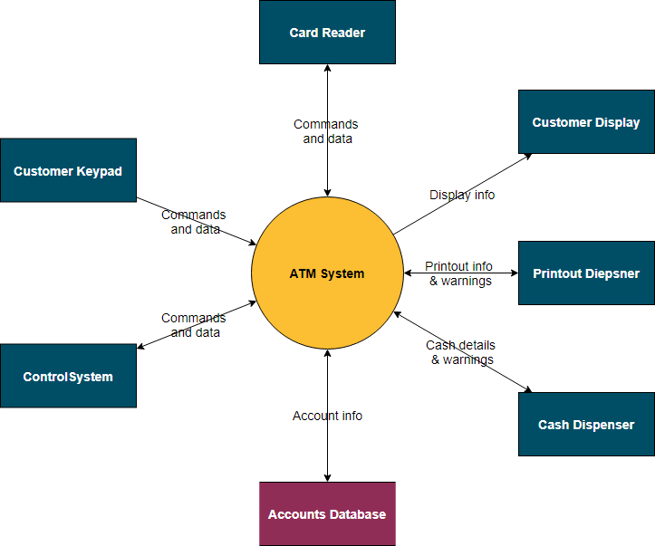
Context Diagram
A context window diagram can be either a system context diagram showing a single process and its external data flows or an AI context window diagram illustrating how a model uses tokens as "working memory". A system context diagram uses a central box for the system and arrows to external entities like users and other systems, as seen in examples like an attendance reporting system or a hotel reservation system
page 06

